Slide 1



Slide 2
MOTIVATIONAL LEADERSHIP
Leading with Passion, Power, and Purpose
Dr. Alex Garcia
www.leadershipdynamicsllc.com

Slide 3

What is Leadership?
“Getting others to do willingly
what you want them to do”

Slide 4
Are You the Type of Leader?
Trust
Respect
Believe-in

Slide 5

Leadership Begins With?
Bringing out the best
in others
Praising a job well done
Offering encouragement
Establishing friendly and
supportive relationships

Slide 6
Motivational Leadership Characteristics
Self-Mastery
SELF-ESTEEM
How Leaders Lead with Passion, Power, & Purpose
Learning Objectives
Self-Direction
BUILD TRUST
PURPOSE
RELATIONSHIPS
POSITIVE ATTITUDE
LISTEN

Slide 7
Self-Mastery
The self-confident ability to crystalize your thinking and establish an exact direction for your own life,
to commit yourself to moving in that direction,
and take determined action to acquire, accomplish
or become, what you identify as the ultimate goal
or goals for your life.

Slide 8

Self-Directed
“The ability to direct your thoughts and actions toward a predetermined goal or objective”

Slide 9

What is Purpose?
The reason for doing
or creating something

Slide 10
Positive Attitude
ATTITUDE
IS A DECISION

Slide 11
Tips to Attitude Change
Your attitude toward life will determine life's attitude toward you
Your attitude toward others will determine their attitude toward you

Slide 12
Tips to Attitude Change
Radiate the attitude of accountability
and trust
Radiate the attitude of well being
and confidence

Slide 13
Attitude
Don’t Just Aspire to Make a Living,
Aspire to Make a Difference!

Slide 14
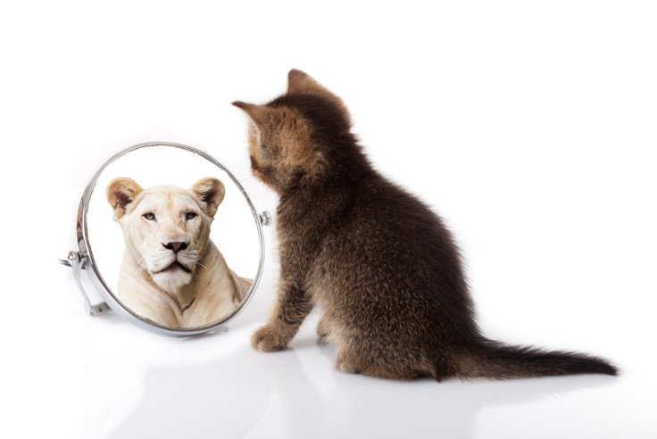
What is Self-Esteem?
How you feel about yourself

Slide 15

People with Low Self-Esteem
Inadequacy
Insecurity
Self-doubt
Guilt
Fear of participation

Slide 16

Rewards of High Self-Esteem
Speak your mind
Are nice and friendly
Have a sense of humor
Believe in your abilities
Will move out of comfort zones
Good with people

Slide 17

Improve Your Self-Esteem
Acts of kindness
Positive self-talk
Treat everyone with respect
Dress and look your best
Accept yourself
Set internal standards

Slide 18

Building Positive Relationships
Building Positive Relationships

Slide 19

Showing Genuine Interest

Slide 20

Practice Basic Good Manners

Slide 21

Be Real
Lose the mask
Be real

Slide 22

Learn to Deal with Difficult People

Slide 23
Adaptive Communication
direct
IN-DIRECT
ASSERTIVE
AGGRESSIVE
PASSIVE
PASSIVE-
AGGRESSIVE

Slide 24

Types of Listening
Ignoring/pretending
Passive
Selective
Attentive
Active

Slide 25
Keys to Active Listening
Give speaker your
full attention
Don’t interrupt
Ask about anything you
don’t understand
Take brief notes
to keep track of details

Slide 26
Diet
Exercise
Focus
alexgarcia@leadershipdynamicsllc.com

